Slide 1

FAVICON’s
Notes:
Hi everyone. My name is Brandon Davis and Today I am going to be discussing Favicons. With you guys. We will first be discussing what a favicon is and what it is used for. I will then be going over how to create one and some basic best practices. We will then go into the code needed in order for a favicon to show up. We will go over where the code should be placed, along with where the associated image that will be used should be placed..

Slide 2
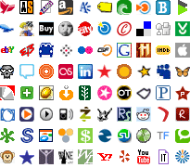
What is A FAVICOn
An Icon associated with a URL
Located in the following areas
Browsers Address Bar
Next to Site Name in a bookmark list
Notes:
What is a favicon. According to the google dictionary a favicon is “an icon associated with a URL that is variously displayed, as in a browser's address bar, on the tab of the page that is opened, or next to the site name in a bookmark list.” As I looked around and viewed many different websites I found that most often a company logo was used as the favicon. Some sites have created a generic favicon that is the first letter of the site name, while others may just create an appealing design that relates to the site. Some sites don’t have favicons at all, as well. One may ask what is the purpose or reason a favicon is needed. The answer is simple, it is to enhance your viewers experience and make your site easily accessible and identifiable. If you have a lot of websites bookmarked, it has been found that it is easier to pick out an icon, rather than to read through each site name. This making your site easier to identify in the list. One of the more challenging tasks is building the favicon that will best suit your site. Over the next few slides we will go over how to create a favicon and the code needed in order to view the favicon on your html page.

Slide 3
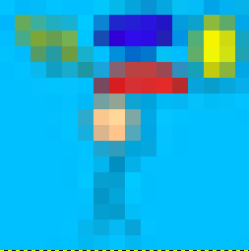
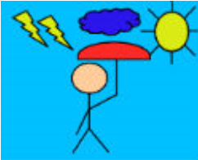
Sizing a favicon using photoShop Or other program
Must be 16x16 pixels or 32x32 pixels
PNG or ICO Formats
Create high-quality favicons using a variety of programs
Notes:
When creating a favicon the sizing and formatting are everything. As shown above I have two different pictures that are the same, but paint two very different pictures. From my studies and testing I found that when creating a favicon you should either use a png file or ico file when saving. If you already have an image that you want to use, you should use a program to convert it to one of these filetypes for best results. I attempted to create a favicon from some images I had and when I adjusted the size of the picture, the results were horrible. Some of them I could not tell what the picture was, and others would have needed a lot of work. The format for the image you have chosen must be16x16 pixels or 32x32 pixels. When you attempt to make a large picture smaller the quality goes down drastically in a lot of cases. One option when creating the favicon is to load the image into photoshop (or another image editing software) and then scale the size down to the recommended size. You can then zoom in and view what it will look like. From here you can fix any issues that you are seeing. I think the easier route, from what I have seen with my limited knowledge, would be to create a new image that starts at the correct size and then save it.

Slide 4
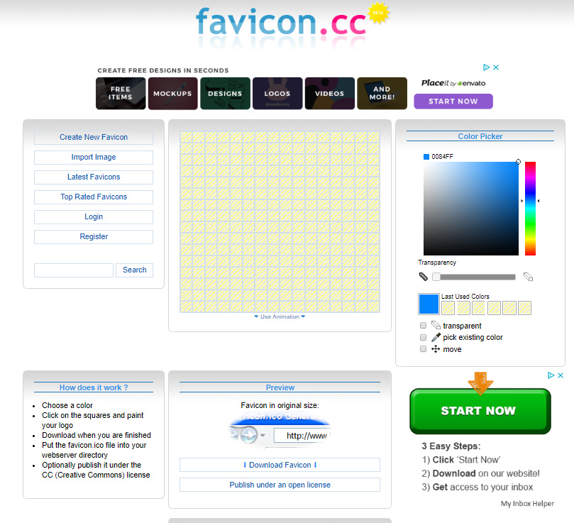
Sizing a Favicon Using a Website
Websites to help create or adjust image sizes
https://www.favicon.cc/
https://www.icoconverter.com/
https://icoconvert.com/image_to_icon_converter/
Notes:
There are also many websites out there that will help you to create or enhance an image. The image shown in this slide above is a screen shot from Favicon.cc. This site allows a user to go in and either upload an image to convert to a favicon, or create a new favicon. The user then can download the new images for use. Icoconverter.com allows you to convert and image to various format sizes and then saves one document with multiple image sizes that can be used to help view the favicon in different screen sizes. Icoconvert.com allows you to convert documents to various formats as well. It will also allow a user to convert a large group or a batch of documents all at once. There were sites that would even help you create a favicon. Lot of different tools out there to help you to achieve the best results possible for your favicons.

Slide 5
Code for Favicon
Definitions
link rel - The link element creates a link between your HTML document and an external resource. The rel attribute specifies the relationship between the two documents
type - The type attribute specifies the Internet media type
href - Specifies the linked document, resource, or location
Example Code:
<link rel="shortcut icon" type="image/ico" href="images/favicon.ico" />
Notes:
Once you have your image created we are now ready to incorporate it into our HTML page. The code for the favicon should be placed in the head of the HTML document. The images should be placed in the images folder or an equivalent location and then the href should point at the truncated location. The coding of the favicons is pretty straight forward, but lets go over some definitions. link rel - The link element creates a link between your HTML document and an external resource. The rel attribute specifies the relationship between the two documents. Type - The type attribute specifies the Internet media type. href - Specifies the linked document, resource, or location. Once we combine these our HTML will know where to go to retrieve the favicon and will place it as a image in the various locations discussed earlier.

Slide 6
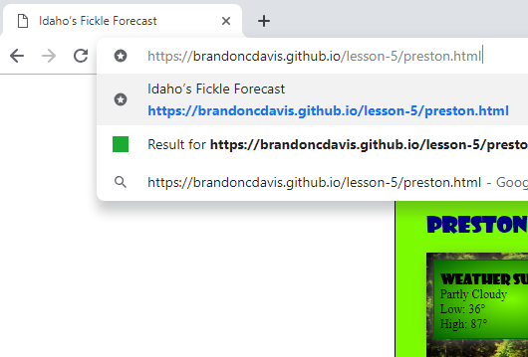
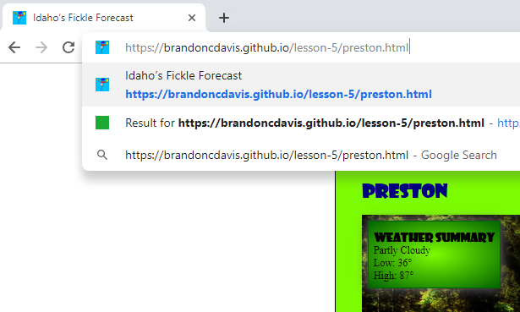
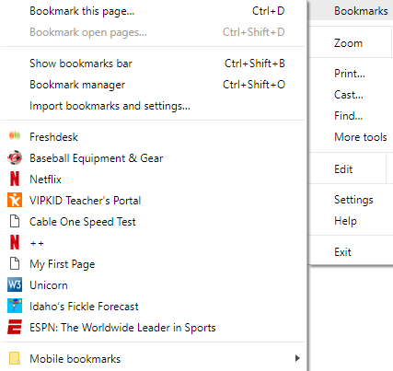
Results
Notes:
To wrap up my presentation, I wanted to give everyone a visual. I went ahead and updated my website that I am working on for this class to have a favicon. The first picture shows what the site address bar, the tab associated with the page, and the history drop down for previous sites visited looks like. I then did a screenshot of my page after I created my favicon using a internet resource and saved my file in my images location. In order for the file to show I first updated my code and saved my change. I then went ahead and used visual studio code to push those changes to my site and that is the second picture. Please note that the favicon does not appear right away. In all of my testing I found that I needed to be patient. This cause me a lot of frustration and wasted time at first. If you think you have done it wrong, I would walk away for five minutes and then come back. I would clear out the cashe and do a hard reload for the site using the Devtools. Once the pages update you will be able to see the favicon in several different areas. As you can see in the second screenshot the changes were made, I also included a screenshot of what the favorites menu looks like with the favicon. I have enjoyed learning about favicons and hope that in some way this has helped increase your understanding of what a favicon is and how it works. Thanks.

